Slide 1
Data Mining
Lecture Notes for Chapter 5
Clustering (Unsupervised learning)
by

Slide 2
Outline
Supervised vs Unsupervised learning
Clustering
What is clustering for?
K-means clustering
Hieratical clustering

Slide 3
Supervised learning vs. unsupervised learning
Supervised learning: Learn from past experience.
This experience is represented as labels (class values)
Unsupervised learning: Try to find connection, based on which you group/segment the data
The connection here is the patterns in the data.
E.G., Similar examples should be together

Slide 4
Clustering
Clustering is a technique for finding similarity groups in data, called clusters. I.e.,
It groups data instances that are similar to (near) each other in one cluster and data instances that are very different (far away) from each other into different clusters.
Clustering is often called an unsupervised learning task as no class values denoting an a priori grouping of the data instances are given, which is the case in supervised learning.
Due to historical reasons, clustering is often considered synonymous with unsupervised learning.
In fact, association rule mining is also unsupervised
This chapter focuses on clustering.

Slide 5
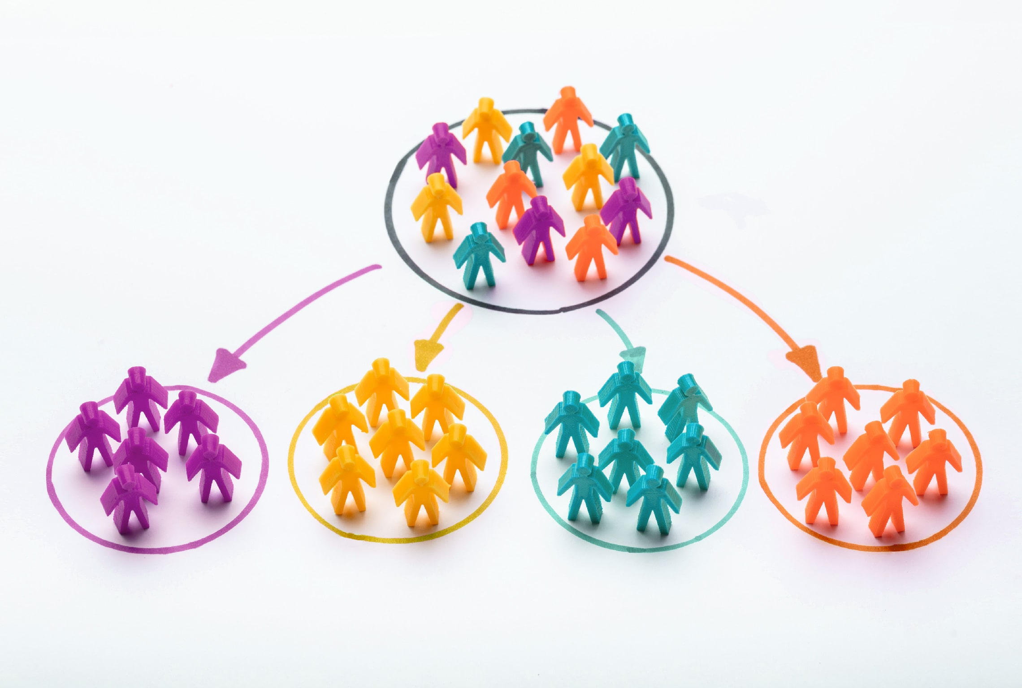

Slide 6
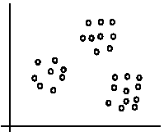
An illustration
The data set has three natural groups of data points, i.e., 3 natural clusters.

Slide 7
Cluster Analysis for Data Mining
Clustering results may be used to
Identify natural groupings of customers
Identify rules for assigning new cases to classes for targeting/diagnostic purposes
Provide characterization, definition, labeling of populations
Decrease the size and complexity of problems for other data mining methods
Identify outliers in a specific domain (e.g., rare-event detection)

Slide 8
What is clustering for?
Let us see some real-life examples
Example 1: groups people of similar sizes together to make “small”, “medium” and “large” T-Shirts.
Tailor-made for each person: too expensive
One-size-fits-all: does not fit all.
Example 2: In marketing, segment customers according to their similarities
To do targeted marketing.

Slide 9
What is clustering for? (cont…)
Example 3: Given a collection of text documents, we want to organize them according to their content similarities,
To produce a topic hierarchy
In fact, clustering is one of the most utilized data mining techniques.
It has a long history, and used in almost every field, e.g., medicine, psychology, botany, sociology, biology, archeology, marketing, insurance, libraries, etc.
In recent years, due to the rapid increase of online documents, text clustering becomes important.

Slide 10
Notion of a Cluster can be Ambiguous
How many clusters?
Six Clusters
Two Clusters
Four Clusters

Slide 11
Aspects of clustering
A clustering algorithm
Partitional clustering
Hierarchical clustering
…
A distance (similarity, or dissimilarity) function
Clustering quality
Between-clusters distance ⇒ maximized
Within-clusters distance ⇒ minimized
The quality of a clustering result depends on the algorithm, the distance function, and the application.

Slide 12
Partitional Clustering
Original Points
A Partitional Clustering

Slide 13
Hierarchical Clustering
Traditional Hierarchical Clustering
Traditional Dendrogram
Non-traditional Hierarchical Clustering
Non-traditional Dendrogram

Slide 14
K-means clustering
K-means is a partitional clustering algorithm
Let the set of data points (or instances) D be
{x₁, x₂, …, x_{n}},
where x_{i} = (x_{i1}, x_{i2}, …, x_{ir}) is a vector in a real-valued space X ⊆ R^{r}, and r is the number of attributes (dimensions) in the data.
The k-means algorithm partitions the given data into k clusters.
Each cluster has a cluster center, called centroid.
k is specified by the user

Slide 15
K-means algorithm
Given k, the k-means algorithm works as follows:
Randomly choose k data points (seeds) to be the initial centroids, cluster centers
Assign each data point to the closest centroid
Re-compute the centroids using the current cluster memberships.
If a convergence criterion is not met, go to 2).

Slide 16
Stopping/convergence criterion
no (or minimum) re-assignments of data points to different clusters,
Or no (or minimum) change of centroids
|Previous centriod – current centriod| < threshold

Slide 17
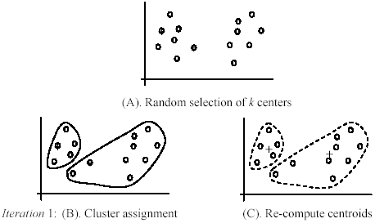
An example
+
+

Slide 18
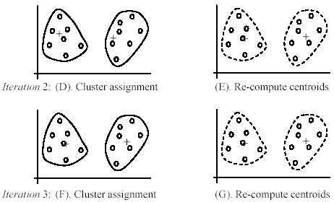
An example (cont …)

Slide 19
Strengths of k-means
Strengths:
Simple: easy to understand and to implement
Efficient: Time complexity: O(tkn),
where n is the number of data points,
k is the number of clusters, and
t is the number of iterations.
Since both k and t are small. k-means is considered a linear algorithm.
K-means is the most popular clustering algorithm.

Slide 20
Weaknesses of k-means
The algorithm is only applicable if the mean is defined.
For categorical data, k-mode - the centroid is represented by most frequent values.
The user needs to specify k.
The algorithm is sensitive to outliers
Outliers are data points that are very far away from other data points.
Outliers could be errors in the data recording or some special data points with very different values.

Slide 21
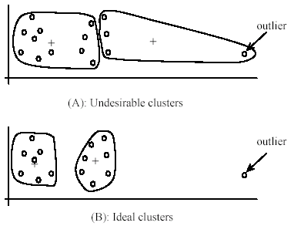
Weaknesses of k-means: Problems with outliers

Slide 22
Weaknesses of k-means: To deal with outliers
One method is to remove some data points in the clustering process that are much further away from the centroids than other data points.
To be safe, we may want to monitor these possible outliers over a few iterations and then decide to remove them.
Another method is to perform random sampling. Since in sampling we only choose a small subset of the data points, the chance of selecting an outlier is very small.
Assign the rest of the data points to the clusters by distance or similarity comparison, or classification

Slide 23
K-means summary
Despite weaknesses, k-means is still the most popular algorithm due to its simplicity and efficiency.
other clustering algorithms have their own lists of weaknesses.
No clear evidence that any other clustering algorithm performs better in general
although they may be more suitable for some specific types of data or applications.
Comparing different clustering algorithms is a difficult task. No one knows the correct clusters!

Slide 24
Hierarchical clustering
Hierarchical clustering is another method for clustering
it organizes the data into hierarchy of clusters
It is divided into two main categories
Agglomerative clustering (bottom-up)
Divisive clustering (top-down)

Slide 25
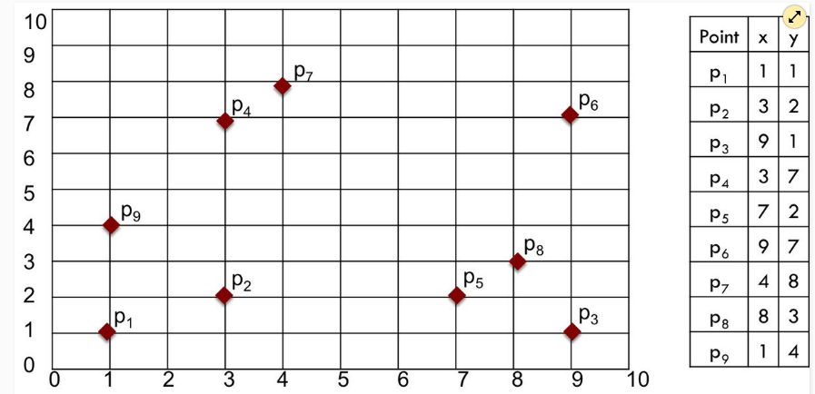
Cont.
In this approach the clustering starts by assigning label for each data point in the dataset

Slide 26
Cont.
In this approach the clustering starts by assigning label for each data point in the dataset

Slide 27
Cont.
Then the similar points are joined together in one cluster

Slide 28
Cont.
Keep merging Until you have K clusters

Slide 29
Cont.
Keep merging Until you have K clusters

Slide 30
Cont.
Keep merging Until you have K clusters

Slide 31
Cont.
Keep merging Until you have K clusters

Slide 32
Cont.
Keep merging Until you have K clusters

Slide 33
Cont.
Keep merging Until you have K clusters

Slide 34
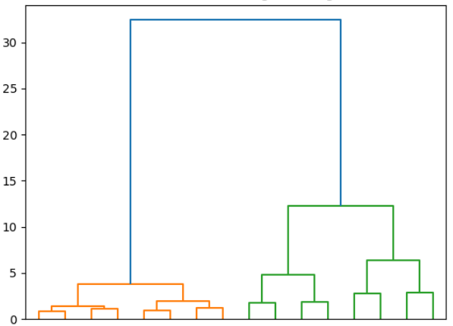
Results
You can easily look at the clustering results using what is called dendrogram.

Slide 35
Cont.
the distance define the number of clusters
For example:

Slide 36
Cont.
the distance define the number of clusters
For example: The following threshold splits the data into 2 clusters

Slide 37
Cont.
the distance define the number of clusters
For example: This threshold splits the data into 3 clusters

Slide 38
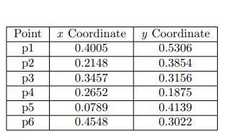
Example: Hierarchical Clustering
Use the sample in Table1 to perform single link and complete link
hierarchical clustering. Show your results by drawing a dendogram

Slide 39
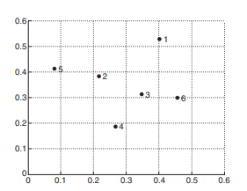

Slide 40
Pros and cons
Pros
hierarchical clustering is easy to implement.
can be plotted as a dendrogram, which makes it easier to understand the data
Cons
Huge time complexity O(N²) compared to K-means.
In large datasets, the dendrogram becomes hard to understand.

